Slide 1
Assignment3 PRESENTATION
16102284 Lee SungHo

Slide 2
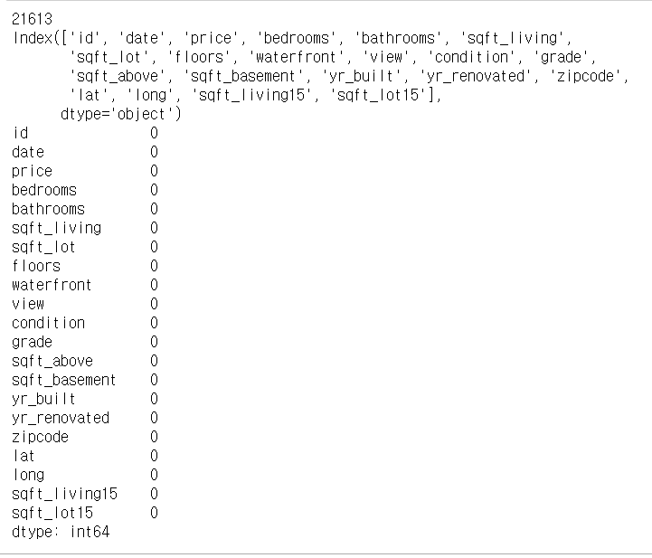
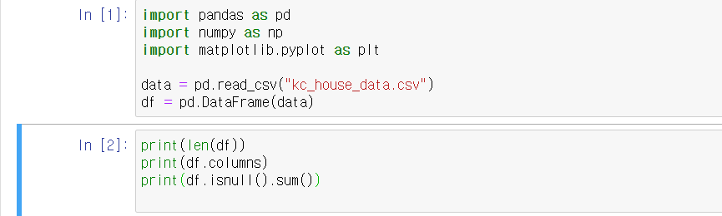
EDA1
First to get a general idea of the data to be analyzed, I used these function. So I know about the number of ‘null’ ,columns, and data’s shape

Slide 3
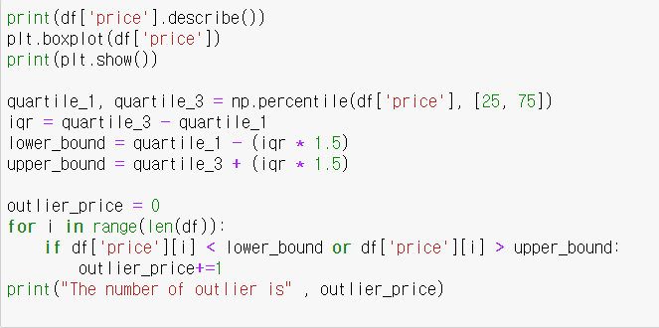
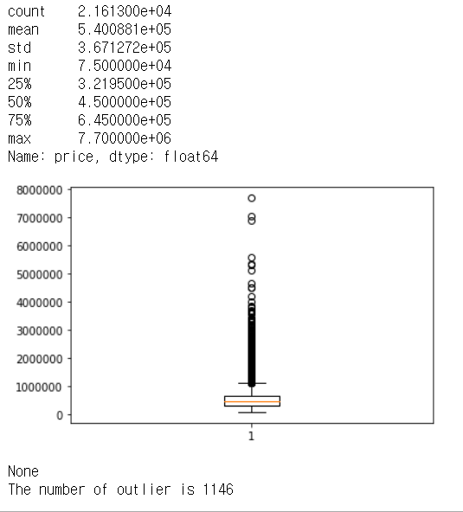
EDA1
Before make a model, I want to know ‘price’ data. So I make a boxplot and we can know data’s descriptive statistics and data’s distribution. For boxplot’s data and mean & median, price graph is right-skewed. Moreover, there are so many outlier using Turkey Statistical Institute.

Slide 4
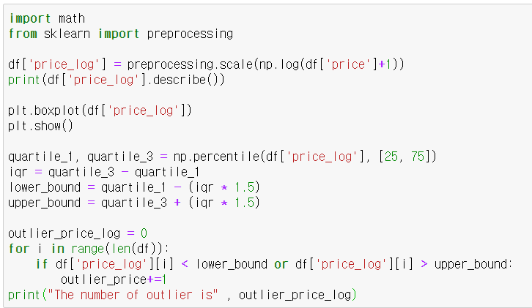
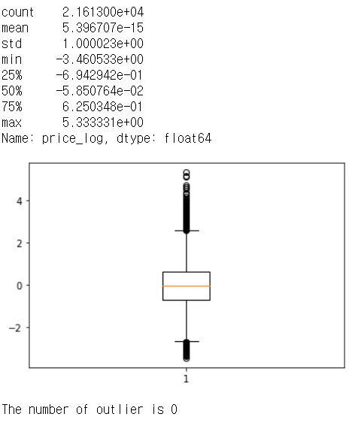
EDA1
So I took a logarithmic value at price column and remake a new column, price_log. As a result data’s descriptive and distribution is better than price column. Moreover there is no outlier value at price_log columns. So I will use this column at target.

Slide 5
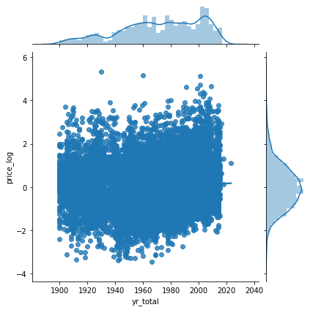

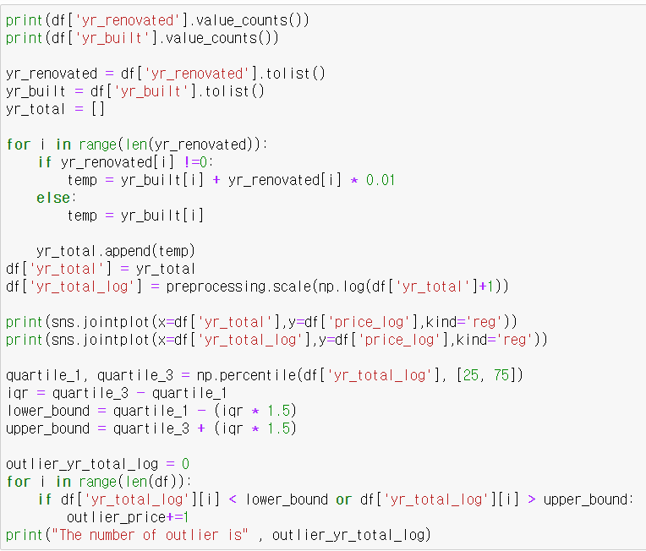
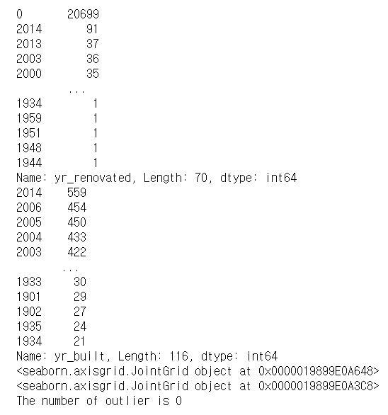
EDA2
Result of value_counts & the number of outlier
I make a new column ‘yr_total’. Because I think the price would be higher for the new building.
And I give some advantages to remodeling year proportionally, although it is not a new building, I thought it would be expensive if it was repaired and well managed. So I make a new column by the square formula. And there is no outlier and relation to price_log column.

Slide 6


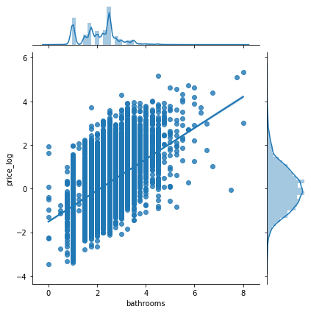
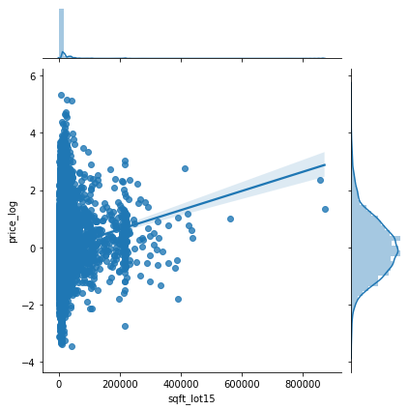
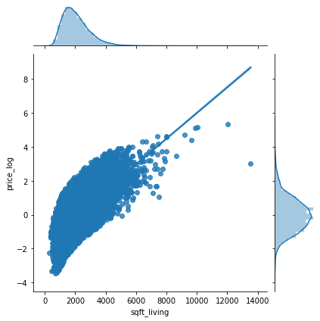
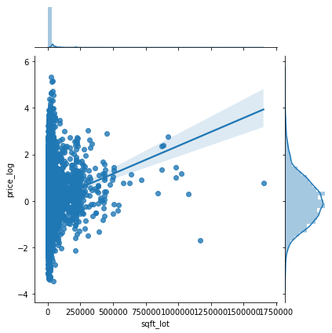
EDA3
And I make scatter plots and regression line at graph to show relation to the price_log. As a result, I think ['bedrooms', 'bathrooms', 'sqft_living', 'floors', 'waterfront’, 'sqft_above’, 'sqft_basement’, 'sqft_living15’] have relation, but ‘sqrt_lot’ and ‘sqrt_log_15’ doesn’t have relation.

Slide 7

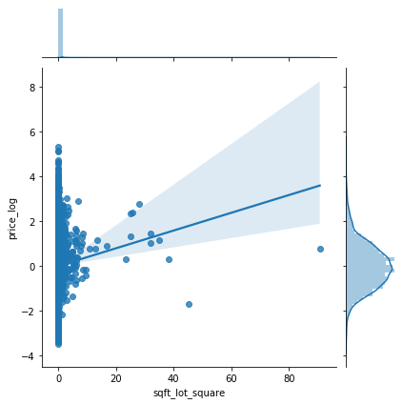
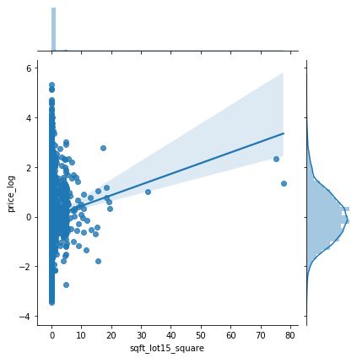

EDA3
So I took a square value at these columns and remake a new columns, but there is no relation too. And I can drop outlier values, but I don’t want to remove because of modeling after.

Slide 8
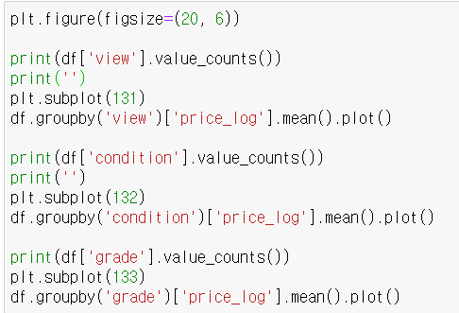
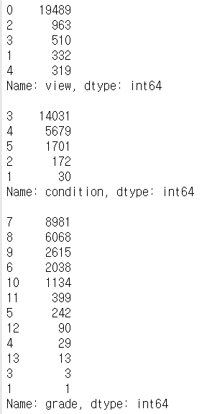
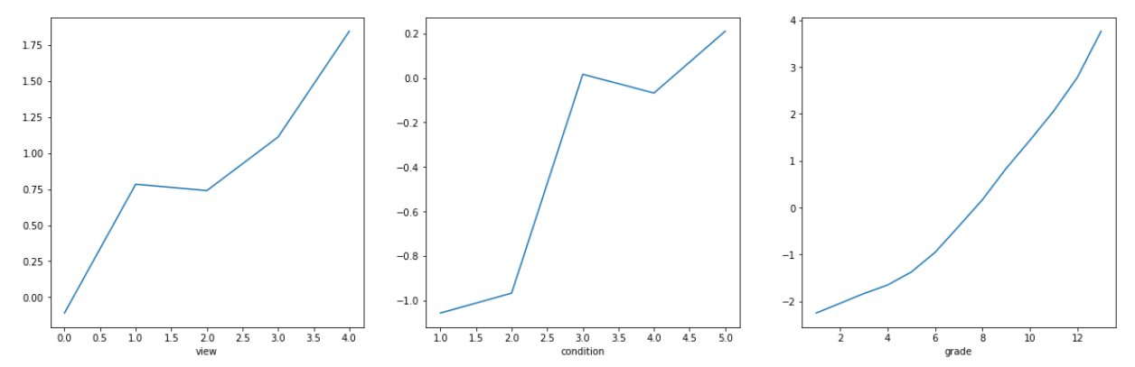
EDA4
And I will EDA ‘view’ , ‘condition’ and ‘grade’ data which is ordinal data. So I will count values and draw graph which shows relation to price_log. As a result, like under, I think the graph is a simple increase and there seems to be no problem with the data. So I will these data at predictor variable
Result of value_counts
Result of drawing graph

Slide 9
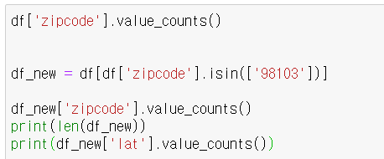
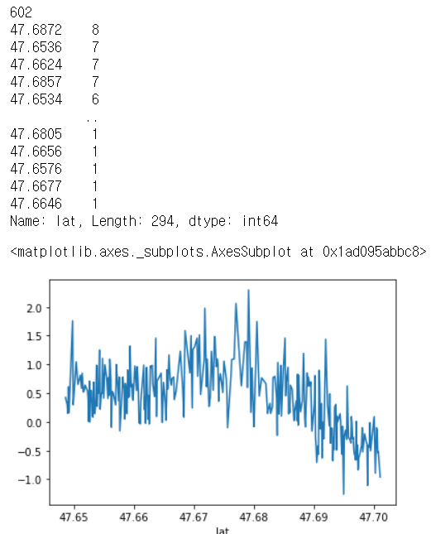
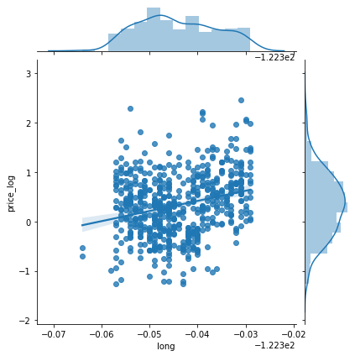
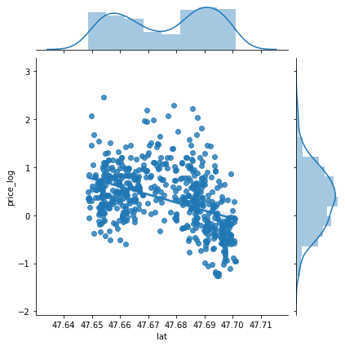
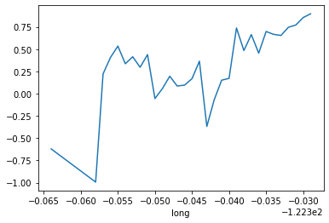
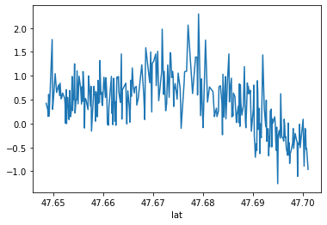

EDA5
This code select some data if ‘zipcode’ is 98103. And I make a graph to explain hypothesis that if zipcode is same, price is similar. For example, the price of house prices in Seoul, such as those in Banpo-dong and Seocho-dong, varies depending on the town. However there are many difference in same zipcode, So my hypothesis is wrong. In my opinion, I think these ‘zipcode’ doesn’t represent ‘lat’ and ‘long’ , so I have to be removed for model’s performance.

Slide 10
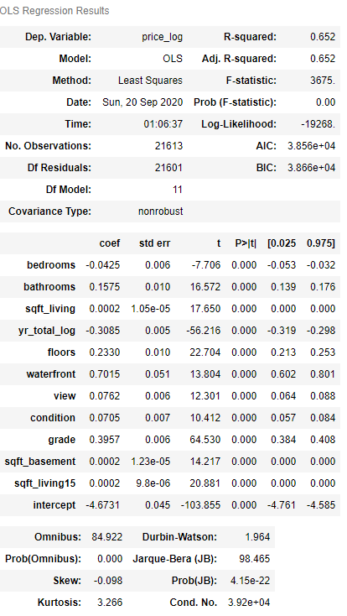
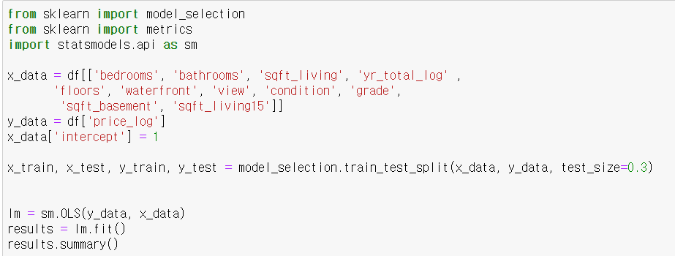
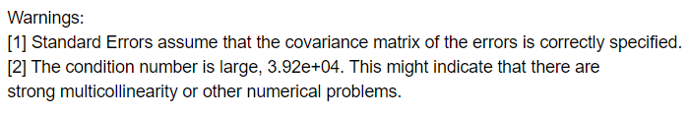
MODELING
I make a multiple linear model, using the data I pre-processed earlier. And R-squared is quite high 0.652, and there are no predictors corresponding to the null hypothesis. However, the model warns that there is a problem with multicollinearity.

Slide 11
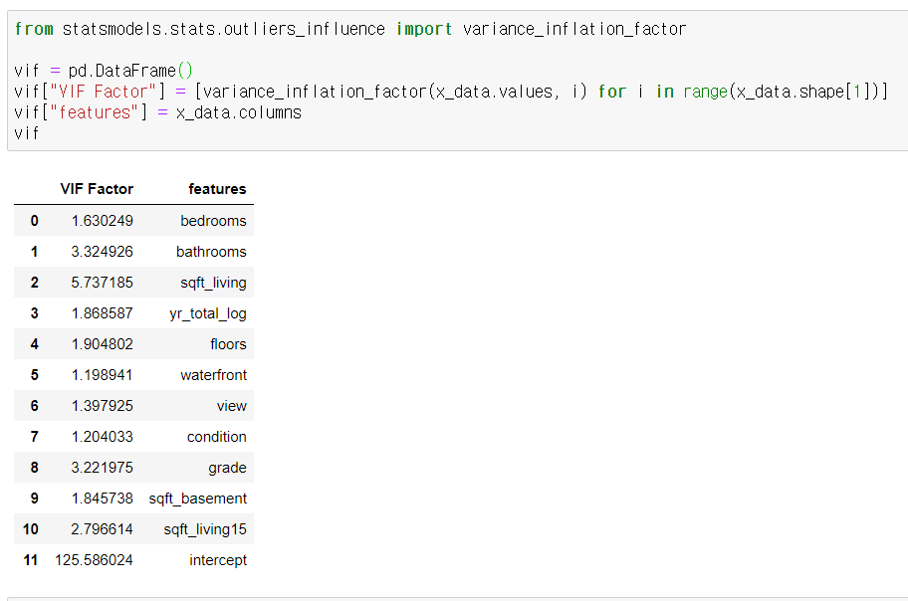
MODELING
So I check model variable’s VIF, But there is no problem( VIF < 10) except intercept. Normally I must remove a predictor of more than 10, but intercept must exist at this model. So I think multiple linear model is wrong.

Slide 12
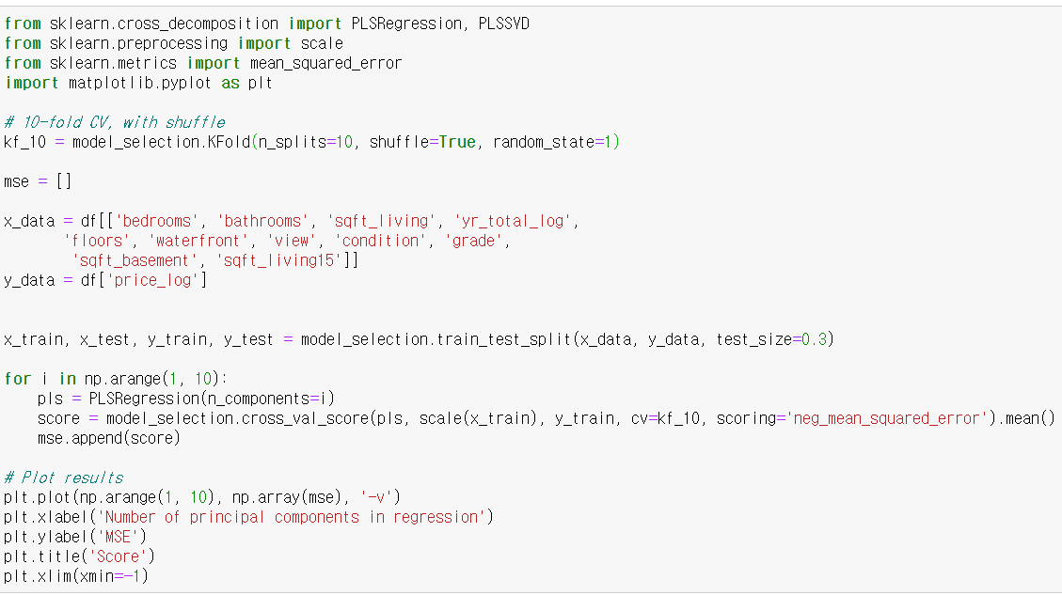
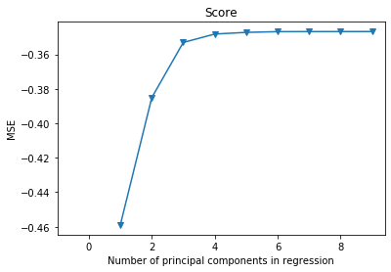
PLS
I think to solve this problem, I have to use another model like regularization model or PLS etc. Then I will use PLS model. For choosing hyper parameter, I make a graph, and this tell us hyper parameter is 3(Elbow point).

Slide 13
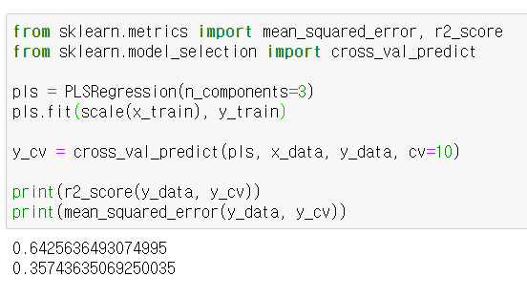
PLS
Now that the hyperparameter has been determined, I am going to create a PLS model, and use 10-fold cross-verification for model verification. And these are scores of PLS Model. It is lower than linear model, but it's a very small difference. So I will choose PLS model because of small difference and multicollinearity problems

Slide 14


